Slide 1
Image Processing - Project 1
Yung-Yu Chen
Praveen Yadav
Shahnawaz Alam
Abishek Kumar
Parth Wadhwa

Slide 2
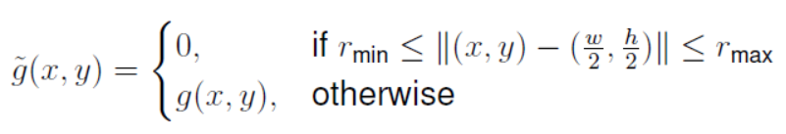
Task 1.1
In this task we are required to compute a new image [g’(x,y)] from an existing one [g(x,y)] using below condition:
where rmin and rmax are user defined constant

Slide 3
Approach toward solution
Reading Image and storing details of each pixel in form of nXm matrix
Find center of the Image
Create placeholder for target image
Compute distance of each pixel from center of the image
If distance of pixel is in between upper bound (rmax) and lower bound(rmin),
turn off this pixel in target Image
Write Image to the disk

Slide 4
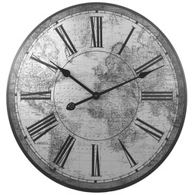
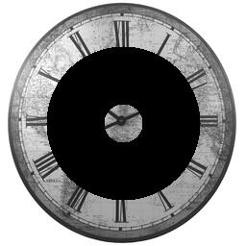
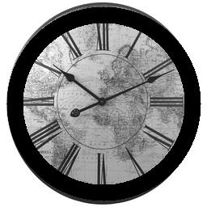
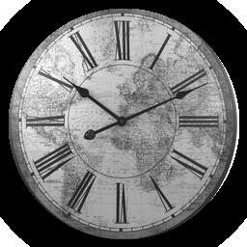

Results
g(x,y)
g’(x,y)
rmin=20,rmax=80 rmin=100,rmax=120 rmin=120,rmax=160
We passed an image of size 6000X4000 as an input, which took approximately 13 minutes to generate the target image (rmin=120, rmax=160)

Slide 5
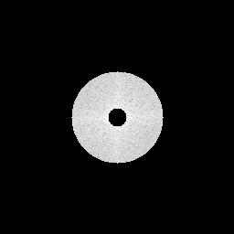
Task 1.3
In this task we are required to implement a band pass filter by defining a band and suppress all of the values out of the rim in the frequency spectrum:

Slide 6
Approach
We first define r_{max} and r_{min}
Apply fourier transform to our image to get G(u, v)
Shift the origin of G(u,v) to the center
Making the values outside of the band(black area) 0(actually a small number)
Apply inverse fourier transform on this “filtered” image
0s
Visualization with logarithm
In practice, we need to suppress the frequencies by making it very small but not directly zero

Slide 7
Analysis
If we take rmin as 0 it will become low pass filter, while if rmin>0 and rmin<rmax it becomes band pass filter.
We mask fourier output in complex space, however while masking we have taken care of masked values to not to be 0, otherwise while visualisation the log transformation would not work. Thus we have considered masking value as 1 (real number)

Slide 8

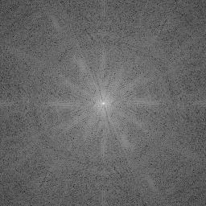
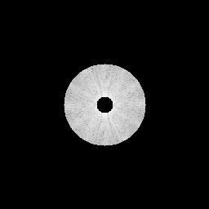

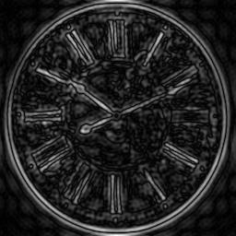
Results
Fourier transformed
Shifted
Filtered
Inverse shifted
Inverse fourier
transformed

Slide 9
Task 1.4
In this task, we are required to reconstruct a image by using the magnitude and phase from two different images.
Magnitude: √(a² + b²)
a+ib
Fast Fourier Transform value form:
Phase: Arctan(b/a)

Slide 10


To Reconstruct: According to the Fourier Transform formula,
We simply calculate the magnitude from G(x,y) (bauckhage.jpg) and the phase from H(x, y) (clock.jpg):
The frequency spectrum of Reconstructed_Image = Magnitude_G * exp( Phase_H )
Inverse fourier transform
Reconstructed_Image

Slide 11

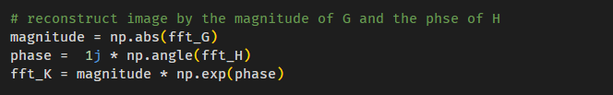
Implementation with python
Calculate FFT for G and H
Compute magnitude of G, phase of H, and generate K
Inverse FFT of K

Slide 12
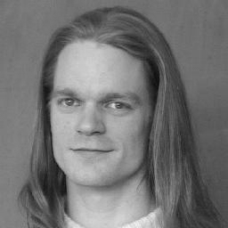
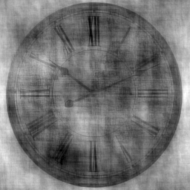
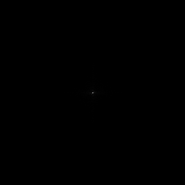
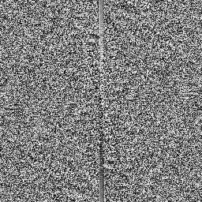
Results
G
H
Conclusion for task 1.4:
Phase component is more important for reconstruction of Image
Phase component contains more information to the singal
magnitude of G
phase of H

